Slide 1

Impact of COVID-19: A Comparative Portfolio Analysis and a glimpse into the future
UofT FinTech - Group 3
Richard Yoo
Jessica Carmichael
Younwoo Choi
Manjari Shukla
Notes:
Title slide
- Name of project, title of course, group members, and date

Slide 2



Summary
This project analyzes the Impact of COVID-19 on the stock market and portfolio earnings.
Purpose
To determine whether there is a positive impact on portfolio earnings between Jan 2019 – June 2020.
Notes:
As the Global pandemic continues to create uncertainty, the aim of this project is to study:
1. The Impact of COVID-19 so far on the stock market and portfolio earnings.
2. What will happen in the next 10 years to the portfolio we decided on investing today

Slide 3


Objectives
What is the impact of COVID-19 on the stock market?
What is the effect of COVID-19 on the sectors represented in the custom portfolio?
How has COVID-19 affected the FinTech space?
What are the key takeaways from the analysis of portfolio stocks, Fintech ETF, and the overall market?
Notes:
A comparative analysis was done to study the impact of COVID-19 on a custom portfolio of 5 dividend paying stocks. This portfolio is compared with a Fintech ETF and, the S&P 500 Index is used as a benchmark for assessing trends in the stock market.
The reason why we chose to analyze these questions is because the next pandemic isn’t a matter of “If” it will happen but “when” will it happen. We are determining what is the best course of action to financially benefit from an unexpected disruptive event.

Slide 4
Data Used
Historical stock data from top 25 S&P 500 companies (Custom Portfolio. Based on high dividend payments and sector diversification)
Microsoft (Technology Services)
JP Morgan Chase (Financial – Banking)
AT&T (Telecommunications)
ExxonMobil (Energy – Oil & Gas)
Pfizer (Healthcare)
S&P 500 performance; 2007 - 2020
COVID-19 Tracking Data and Statistics
API used for COVID-10 data for USA
GLB X FUNDS/FINTECH THEMATIC ETF(FINX)
Consumer Price Index (CPI), monthly adjusted
Notes:
We have done a comparative analysis on the impact of COVID-19 on the listed custom portfolio of dividend paying stocks chosen from the top 25 S&P 500 companies. This portfolio is compared with the oldest and most established fintech ETF, with the S&P 500 acting as a benchmark

Slide 5


Data Cleaning & Exploration
Combine custom portfolio of daily returns:
Microsoft
JP Morgan Chase
AT&T
ExxonMobil
Pfizer
Combine custom portfolio with FINX ETF, and S&P 500 Returns
Calculate and plot daily returns and cumulative returns
Compare market performance with COVID-19 cases
Notes:
DISCUSS PROBLEMS here
Our clean up process involved setting weights to the custom portfolio and calculating the daily returns; then, combining the custom portfolio, FINX ETF, and S&P500 returns.
We conducted a Monte Carlo Simulation to determine possible future outcomes of investing in these assets based on 252 trading days. We then calculated the mean of the daily returns, the daily volatility, annualized STD, all to determine which portfolios are risker than the s&p500

Slide 6
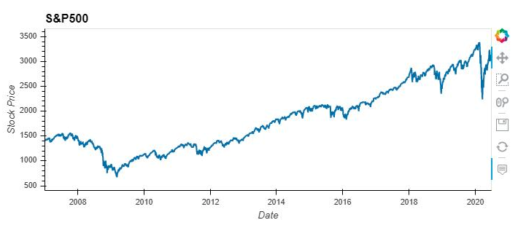


S&P 500 Performance
Q1. What is the impact of COVID19 on the stock market?
2007 - 2020
Feb 19th - $3,386
S&P 500 will be used as a benchmark for assessing trends in the market
The S&P 500 closed Q2 2020 up 19.95% accounting for its best quarter since Q4 1998 when the index gained 20.87%.
March 20th - $2,480
Notes:
Policy actions across the globe, both in terms of monetary and fiscal stimulus packages, have cushioned the economic damage and paved the road to recovery. The S&P 500 has gained strength based on a Federal Government stimulus package and the Federal Reserve rate cuts. The S&P 500 closed Q2 2020 up 19.95% accounting for its best quarter since Q4 1998 when the index gained 20.87%.

Slide 7
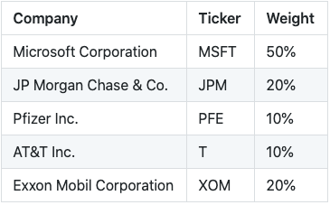
Custom Portfolio
Weights
5 dividend paying stocks chosen from S&P 500 top 25 performing companies
Compare this portfolio with FinTech ETF
The 18-month timeframe has been chosen to represent pre COVID-19 to present time.
Notes:
Our choice of stocks in the custom portfolio was based on sector diversification. The 5 stocks part of the portfolio represent the following sectors: Information technology, healthcare, communication services, financials, and energy

Slide 8
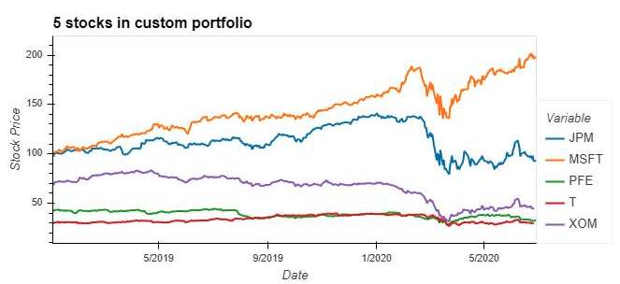
Custom Portfolio Performance
Tech, Healthcare, & Communication Services
Tech firms will need to evaluate impacts on supply chain, market demand and employees.
Healthcare service facilities were hit hard, however, healthcare stocks had a mild impact relative to other sectors
Integration of telecommunications was a critical component to workflow during this time
Notes:
TECH
In the short-term, supply disruption will reduce manufacturing and assembly capacity, plant reopening's will be further delayed by lags in component supply, and travel bans will exacerbate workforce shortages and consumer demand. The good news is High tech companies are set up for remote work more than other industries and so will suffer less of a workplace culture shock.
The shift to working from home with the help of digital collaboration tools is likely to drive demand for High tech in many categories. A growing need for infrastructure to support this shift, like cloud computing for business or increased broadband consumption for consumers.
HEALTHCARE
The coronavirus pandemic has put health care at the forefront, but it has also put a lot of economic activity from it on hold. Despite a surge in the use of telemedicine, the massive pullback in services has hit the health-care sector hard. Hospitals, outpatient surgical centers and doctor’s offices reporting big losses and cutting jobs as revenues have dried up as the world is focusing on emergency or COVID related services. However, the industry impact will be mild compared to disruptions in other sectors. Drug makers whose products are effective against COVID-19 will benefit financially. It is expected that there will be greater investment in pandemic prevention to help the industry in coming years.
COMMUNICATIONS SERVICES
The pandemic has demonstrated the critical importance of the integration of telecommunications infrastructure within workplaces by keeping organizations and societies connected and running. The communications sector has remained “mission-critical” to keep economies moving under the lockdown in at least three different ways:
1. Providing business-critical connectivity;
2. Facilitating work-from-home arrangements;
3. Keeping individuals and societies connected and informed, with access to medical, financial, commercial, and other essential services during mandated social isolation.

Slide 9
Custom Portfolio Performance
Financial & Energy Industries
Expected low or negative rates for several more years
May reduce profit and labor needed for banks
Reduced interest rates creates the potential for prolonged recession
Petroleum industry experienced a 40% drop due to decreased demand and a production dispute between Saudi Arabia and Russia
Notes:
FINANCIAL INDUSTRY
Central banks are expected to keep rates low for several more years, which has the potential to reduce banks’ profits and the labour needed to operate. The outcome of reduced interest rates, business activity, and large scale non-performing loans, has the potential to become a significant contributing factor to a prolonged recession.
This pandemic will accelerate the shift to digital processes and services for both consumers and firms. ‍
ENERGY
Between February 2020 and March 2020 the petroleum industry had experienced a 40% drop in price due to the outbreak; however, it was not the only factor contributing to the sharp international decline of oil prices. Saudi Arabia and Russia were not able to resolve the dispute of whether to cut back on oil production to match the decreasing demand of gas. Due to this lack of demand from travel restrictions, and without the decrease of production, the Oil and Gas industry was drastically impacted. Many countries rely on petroleum revenue just as much as energy companies do; both these dependents have been facing disaster with labour lay-offs resulting in a decrease in family income, and less household spending.

Slide 10
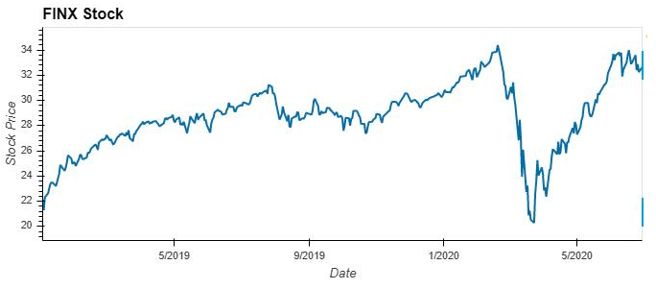
FinTech ETF
GLB X FUNDS/FINTECH THEMATIC ETF(FINX)
Oldest & most established FinTech ETF
47.33% appreciation between Jan 2019 – June 2020
Manage risk and lower costs
June 9 - $33.52
Feb 19 - $33.79
March 23 - $20.30
Notes:
Although COVID-19 continues to create uncertainty, the story is a little different for the big fintech companies. As the economy shows a sign of slow recovery, many big fintech companies will be forced to utilize their skills and technologies to create new opportunities to adapt to our current market.
FinTech must be prepared not just to accommodate this increased demand but also to scale up their enterprise IT infrastructure while adapting to the new world, just like everyone else. ‍
Capital market fintechs should be focused on better managing risk and lowering costs (outsourced trading, cloud-based delivery) that will gain favor as brokers and asset managers cut costs to maintain margins. Regtech and compliance fintechs will remain popular as a market dislocation doesn’t impact demand for their services. Investors may double down on these investments, boosting their valuations. They may be one of the few bright spots in an otherwise tough fintech market.

Slide 11
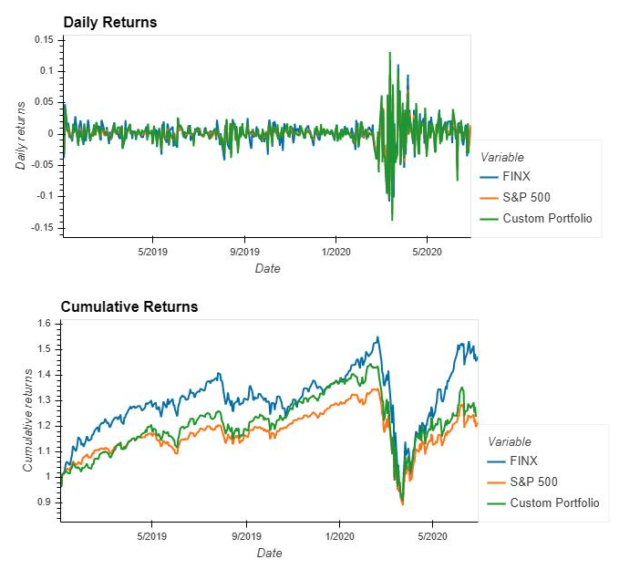
Comparative Analysis
The Custom Portfolio has the highest variations in returns
FINX and Custom portfolio outperformed the benchmark S&P 500.
Custom portfolio has more risk than FINX and S&P 500
Notes:
Daily returns show higher variations in returns for the custom portfolio
Cumulative returns show that both FINX and the Custom portfolio outperformed the benchmark S&P 500.
Risk Analysis (STD rolling 21-day) showed that the custom portfolio has more risk than FINX and S&P 500

Slide 12
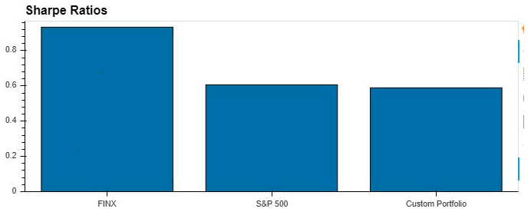
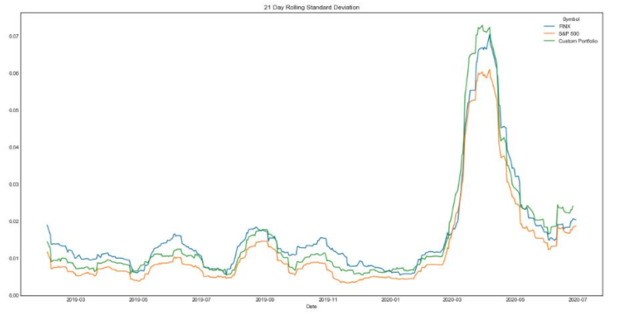
Risk Analysis
Sharpe Ratios & Rolling 21-day STD
Rolling 21-day STD :
FINX - 0.021597
S&P 500 - 0.017911
Custom Portfolio - 0.021822
Notes:
The Sharpe ratios and the rolling 21-day standard deviation both show that the custom portfolio is riskier than FINX and the market.

Slide 13
10-year performance forecast
COMPARISON POINT 1
Notes:
Governments around the globe have already committed about $8 trillion to address the health, social and economic ravages of the COVID-19 pandemic. This price tag (which continues to grow) includes direct spending, equity injections, loans and guarantees. It is more than four times what all the countries on the planet collectively spent on military, weapons and war in 2019. It is a staggering 9.5% of pre-COVID global GDP.
As we deal with and recover from this pandemic, we need to do so in a way that better prepares us to deal with future pandemics and other unpredictable but inevitable large-scale disasters, like very big earthquakes, tsunamis and hurricanes.
In the last 20 years, we've had six significant threats like SARS, MERS, Ebola, avian influenza and swine flu. One can therefore predict that there is no doubt we will see another stock market crash due to a large-scale disaster.
We don't know when the next market crash will happen. It is inevitable but we cannot predict with certainty but we can prepare for the future. Keeping that in mind, we have made an attempt to evaluate the performance of our custom portfolio, the fintech ETF and the S&P 500 for the next 10 years.

Slide 14

Actions to take before the next crash 1. Emergency Savings 2. Expected Expenses 3. Investing to profit from the next crash
Q4. What are the key takeaways from the analysis of portfolio stocks, FinTech ETF, and the overall market now and ten years down the road?
Notes:
Emergency Savings: In addition to having appropriate kinds of and amounts of insurance, we should aim to have cash savings that can cover six or more months of basic living expenses.
Expected expenses: While your emergency savings is preparing you for unexpected near-term needs, one should also prepare your portfolio for those expected needs. Investments away from stocks and into high-quality bonds. The goal is having a few years' expenses in these low-volatility assets before you need them.
Investing to profit from the next crash: Setting aside cash to invest in the next crash. A small portion of one’s portfolio say 5% of what would normally be investment in stocks can be held in cash to invest when the market drops quickly.
Investing half this cash when stocks fall 10% from a recent high, investing half of the remaining cash when stocks fall 20% and the rest at the 30% drop.
Stock market history shows that we see 10% declines about once every year or two, 20% declines about once every five to seven years; a 30% decline has happened only six times in the past 70 years. Going by history, one can use this probability to take advantage of future downturns in the market.

Slide 15
Sources
https://www.spglobal.com/ratings/en/research/articles/200316-pharma-industry-only-moderately-affected-while-helping-mitigate-covid-19-pandemic-impact-11391384
https://www.accenture.com/ca-en/services/consulting/coronavirus-industry-impact
https://fintech-bulletin.com/the-impact-of-covid-19-on-different-fintech-sectors/
https://www.forbes.com/sites/chunkamui/2020/05/07/5-ways-our-coronavirus-recovery-strategies-might-make-or-break-the-future-part-1/#1f82c7c212b4
https://www.bbc.com/news/science-environment-52775386
https://www.fool.com/investing/2020/06/06/yes-another-stock-market-crash-is-coming-how-to-be.aspx
https://finance.yahoo.com/news/where-p-500-2030-heres-193118911.html
https://www.investopedia.com/articles/personal-finance/022216/put-10000-sp-500-etf-and-wait-20-years.asp
https://thefinancialbrand.com/96254/covid-19-impact-future-fintech-banking/
https://www.kaggle.com/gauravarena/canada-covid-19-impact-analysis
https://www.pwc.com/us/en/library/covid-19/coronavirus-technology-impact.html
https://www2.deloitte.com/global/en/pages/about-deloitte/articles/covid-19/understanding-covid-19-s-impact-on-the-technology-sector-.html
https://www.marketdataforecast.com/blog/impacts-of-covid19-on-information-technology-industry
https://www.investmentexecutive.com/news/research-and-markets/the-financial-industry-will-be-fundamentally-transformed-by-covid-19/
https://www.tcs.com/content/dam/tcs/pdf/Industries/Banking%20and%20Financial%20Services/COVID-19-Crisis-Implications-for-financial-services-industry.pdf
https://www2.deloitte.com/global/en/pages/about-deloitte/articles/covid-19/covid-19-s-impact-on-banking---capital-market-institutions-.html
https://www.cbinsights.com/research/fintech-covid-outlook/
https://www.kaggle.com/kittishane/covid-19-and-its-impact-on-business-in-each-sector
https://www.ifc.org/wps/wcm/connect/1d490aec-4d57-4cbf-82b3-d6842eecd9b2/IFC-Covid19 Telecommunications_final_web_2.pdf?MOD=AJPERES&CVID=n9nxogP https://www.fidelity.ca/fidca/en/products/fh https://globalnews.ca/news/6649509/coronavirus-gas-prices-canada/ https://www.marketwatch.com/investing/index/dwcogs/charts https://www.marketwatch.com/investing/stock/pfe/charts https://www.forbes.com/sites/jeffcamarda/2020/07/13/does-sp-500--us-economy--covid-stock-bubble/#180612385daa https://www.accenture.com/_acnmedia/PDF-126/Accenture-COVID-19-Communications-Media-Industry-Report-5.pdf https://www.patriotinvestment.com/blog/quarterly-market-commentary-first-quarter-2020
Notes:
UofT FinTech - Group 3
Richard Yoo
Jessica Carmichael
Younwoo Choi
Manjari Shukla

Slide 16
THANK YOU
Group 3
Richard Yoo
Jessica Carmichael
Younwoo Choi
Manjari Shukla
Notes:
UofT FinTech - Group 3
Richard Yoo
Jessica Carmichael
Younwoo Choi
Manjari Shukla

